Slide 1
AI POWERED PREDICTION OF STRESS LEVEL WITH THE CO ORDINATION OF HEART AND BRAIN USING MACHINE LEARNING

Slide 2
Abstract:
NeurocardioSync is a cutting-edge software system that leverages machine learning algorithms to predict an individual’s stress levels by analyzing physiological and neurological parameters related to the heart and brain. Human daily activities and lifestyle habits can gradually disrupt the natural coordination between the cardiovascular and nervous systems, leading to chronic stress and associated health issues. Conventional health checkups often fail to detect these subtle changes early due to their infrequent nature. NeurocardioSync continuously monitors relevant heart and brain signals, processes them using advanced machine learning models, and provides accurate stress predictions. This proactive approach enables early detection and personalized interventions to maintain mental and physical well-being. The system integrates data-driven insights, real-time analysis, and predictive intelligence to offer a comprehensive understanding of brain-heart interactions under various conditions.
Keywords:
Stress prediction, Brain-heart coordination, Machine learning, Physiological monitoring, Neural signals, Cardiovascular signals, Neurocardiac health, Chronic stress detection, Health analytics.

Slide 3
Existing System:
Recent advancements in the manufacturing and commercialisation of miniaturised sensors and low-cost wearables have enabled an effortless monitoring of lifestyle by detecting and analysing physiological signals. Heart rate variability (HRV) denotes the time interval between consecutive heartbeats. The HRV signal, as detected by the sensors and devices, has been popularly used as an indicative measure to estimate the level of stress, depression, and anxiety. For years, artificial intelligence (AI)-based learning systems have been known for their predictive capabilities, and in recent years, AI models with deep learning (DL) architectures have been successfully applied to achieve unprecedented accuracy. In order to deter mine effective methodologies applied to the collection, processing, and prediction of stress from HRV data, this work presents an in depth analysis of 43 studies reporting the application of various AI algorithms. The methods are summarised in tables and thoroughly evaluated to ensure the completeness of their findings and reported results. To make the work comprehensive, a detailed review has been conducted on sensing technologies, pre-processing methods applied on multi-modal data, and employed prediction models. This is followed by a critical examination of how various Machine Learning (ML) models, have been utilised in predicting stress from HRV data. In addition, the reported results from the selected studies have been carefully analysed to identify features that enable the models to perform better. Finally, the challenges of using HRV to predict stress are listed, along with some possible mitigation strategies. This work aims to highlight the impact of AI-based stress prediction methodologies from HRV data, and is expected to aid the development of more meticulous techniques.

Slide 4
Disadvantages:
Miniaturized wearable sensors may suffer from noise, signal drift, or poor placement, which can affect the accuracy of HRV measurements and, consequently, stress predictions.
Most systems rely heavily on HRV alone, without fully integrating other physiological signals (EEG, GSR, respiratory rate), which may limit the prediction accuracy for complex stress scenarios.
HRV patterns can vary significantly between individuals due to age, gender, fitness level, or pre-existing health conditions, making it challenging for AI models to generalize across diverse populations.
HRV data alone cannot account for psychological or environmental factors influencing stress (e.g., workload, lifestyle, emotional state), which may lead to false positives or negatives.

Slide 5
Proposed System:
The proposed system NeurocardiaSync is an AI powered stress prediction framework that continuously analyzes heart and brain related physiological data to assess an individual’s stress level in real time. The system integrates multi modal sensor data, including Heart Rate Variability (HRV) derived from ECG/PPG signals and brain electrical activity (EEG), to capture subtle changes in autonomic and cognitive responses caused by stress. Initial data acquisition collects real time signals during typical daily activities using wearable sensors. Next, advanced signal processing methods extract meaningful features such as HRV metrics and EEG band power indicators. These features are then fed into machine learning models (e.g., ensemble classifiers or deep learning architectures) trained to distinguish between stress levels (low/medium/high). By correlating cardiac dynamics with neural signatures, NeurocardiaSync offers a robust and personalized stress estimation tool that highlights deviations from normal brain heart coordination. The system also provides visual dashboards and alerts to guide users toward timely interventions and lifestyle modifications, thereby promoting better mental and physical health outcomes.

Slide 6
Advantages:
Early Stress Detection: Identifies stress before it manifests as physical or mental health issues.
Continuous Monitoring: Tracks heart and brain coordination in real-time, unlike periodic health checkups.
Personalized Insights: Offers individualized recommendations based on unique physiological patterns.
Data-Driven Approach: Leverages machine learning for accurate and reliable stress prediction.
Preventive Healthcare: Supports proactive management of chronic stress and related health risks.
Non-Invasive: Uses wearable sensors and software-based analysis, ensuring user comfort.

Slide 7
Environmental Requirements:
1. Software Requirements:
Operating System : Windows
Tool : Anaconda with Jupyter Notebook
2. Hardware requirements:
Processor : Intel core i3
Hard disk : minimum 300 GB
RAM : minimum 4 GB

Slide 8
INTRODUCTION:
In today’s fast-paced and digitally driven world, stress has become a common and serious health concern affecting individuals across all age groups. Prolonged exposure to stress can disrupt the natural coordination between the brain and the heart, leading to long-term physical and psychological disorders such as anxiety, depression, hypertension, and cardiovascular diseases. Traditionally, stress assessment relies on self-reported questionnaires or occasional medical checkups, which often fail to capture gradual physiological changes occurring during daily life.
Recent advancements in wearable sensor technology and machine learning have enabled continuous monitoring of physiological signals such as Heart Rate Variability (HRV) and brain electrical activity. While existing systems predominantly focus on HRV-based stress estimation, they often overlook the vital role of brain-heart coordination in accurately identifying stress levels. To overcome these limitations, NeurocardiaSync introduces an AI-powered approach that integrates heart and brain related parameters to deliver more reliable and personalized stress predictions. By leveraging machine learning techniques, the system aims to detect stress early and support preventive healthcare through real-time monitoring and intelligent analysis.

Slide 9
MACHINE LEARNING:
  Machine learning is to predict the future from past data. Machine learning (ML) is a type of artificial intelligence (AI) that provides computers with the ability to learn without being explicitly programmed. Machine learning focuses on the development of Computer Programs that can change when exposed to new data and the basics of Machine Learning, implementation of a simple machine learning algorithm using python. Process of training and prediction involves use of specialized algorithms. It feed the training data to an algorithm, and the algorithm uses this training data to give predictions on a new test data. Machine learning can be roughly separated in to three categories. There are supervised learning, unsupervised learning and reinforcement learning. Supervised learning program is both given the input data and the corresponding labeling to learn data has to be labeled by a human being beforehand. Unsupervised learning is no labels. It provided to the learning algorithm. This algorithm has to figure out the clustering of the input data. Finally, Reinforcement learning dynamically interacts with its environment and it receives positive or negative feedback to improve its performance.

Slide 10
Preparing the Dataset :
This dataset contains number of records of features extracted from patients, which were then used to find the heart attack from the patient.

Slide 11
Literature survey:
General
A literature review is a body of text that aims to review the critical points of current knowledge on and/or methodological approaches to a particular topic.
It is secondary sources and discuss published information in a particular subject area and sometimes information in a particular subject area within a certain time period.
Its ultimate goal is to bring the reader up to date with current literature on a topic and forms the basis for another goal, such as future research that may be needed in the area and precedes a research proposal and may be just a simple summary of sources. Usually, it has an organizational pattern and combines both summary and synthesis.

Slide 12
Literature survey:
Title : AI-Driven Stress Monitoring for Older Adults: A Wearable IOT Solution.
Author: Komal Mishra , Gaurav Bhushan, Amit Kumar Ahuja.
Year : 2021
Stress is a state of increased physical and psychological tension that can significantly affect an individual’s health and well-being. Various physiological, psychological, environmental, and emotional factors contribute to stress, and poor management can lead to serious health consequences. If not addressed well on time, stress may lead to different neurological disorders which can be detrimental to human health. This paper reviews existing research on stress detection and reduction, examining different methodologies and technologies in the field. Despite advances in stress monitoring solutions, most studies focus on younger populations, workplace settings, or general healthcare, with limited attention to elderly individuals in residential care. To address this gap, this paper proposes an IoT (Internet of Things)-enabled wearable wristband designed for the unique needs of elderly residents in care facilities. The device integrates multiple physiological sensors, including Galvanic Skin Response (GSR), skin temperature, Heart Rate Variability (HRV), accelerometer, and gyroscopic sensors, for real-time stress detection using an adaptive fuzzy logic algorithm. Unlike conventional methods, this system offers personalized interventions such as guided relaxation, breathing exercises, music therapy, and light physical activities, tailored to the user’s real-time physiological state.

Slide 13
Literature survey:
Title : Mental Stress Detection In Real Time Using Wearable Sensors And Machine Learning.
Author: MUVVA VENKATESWARA RAO , GORU SONIYA
Year : 2023
When we encounter difficult or taxing circumstances, or stressors, our bodies and minds go into a hyperarousal state, commonly known as stress. Chronic illnesses including anxiety, depression, and cardiovascular disease can develop in people who are exposed to various stressors for an extended period of time, particularly when these stressors happen at the same time. In order to avoid these long-term impacts, it is essential to recognise stress early on, and continuous monitoring provides a viable option. One possibility for personal stress monitoring is the use of wearable devices that can gather data continuously and in real-time, allowing users to keep tabs on their stress levels as the day progresses. This study provides an extensive analysis of several approaches to stress detection that make use of wearable sensors in conjunction with machine learning methodologies. Wearable sensors including electrocardiograms (ECGs), electroencephalograms (EEGs), and photoplethysmography (PPGs) are reviewed, along with the many settings when stress is tracked, such as while driving, learning, or working.

Slide 14
Objectives:
To collect and analyze heart-related (HRV from ECG/PPG) and brain-related (EEG) physiological data.
To extract meaningful features from cardiac and neural signals using advanced signal processing techniques.
To build and train machine learning models for accurate classification of stress levels (low, medium, high).
To integrate multi-modal physiological data for improved stress prediction accuracy.
To provide real-time monitoring and visual insights for better understanding of stress patterns.
To support early intervention and preventive healthcare through intelligent stress analytics.

Slide 15
Scope of the Project:
The scope of this project focuses on the development of an AI-based stress prediction system that utilizes both cardiovascular and neurological parameters. The system is designed to process real-time physiological data collected from wearable sensors and apply machine learning models for stress level classification. NeurocardiaSync can be extended for use in healthcare monitoring, workplace stress management, mental health assessment, and wellness applications. The framework is scalable and can be enhanced in the future by incorporating additional biosignals, cloud-based analytics, mobile integration, and personalized feedback systems. However, the current scope is limited to software-based stress prediction and does not include clinical diagnosis or medical treatment.

Slide 16
List of Modules:
Data Pre-processing
Data Analysis of Visualization
Bagging Algorithm
MLP algorithm
Deployment

Slide 17
PYTHON:
Introduction:
Python is an interpreted high-level general-purpose programming language. Its design philosophy emphasizes code readability with its use of significant indentation. Its language constructs as well as its object-oriented approach aim to help programmers write clear, logical code for small and large-scale projects.

Slide 18
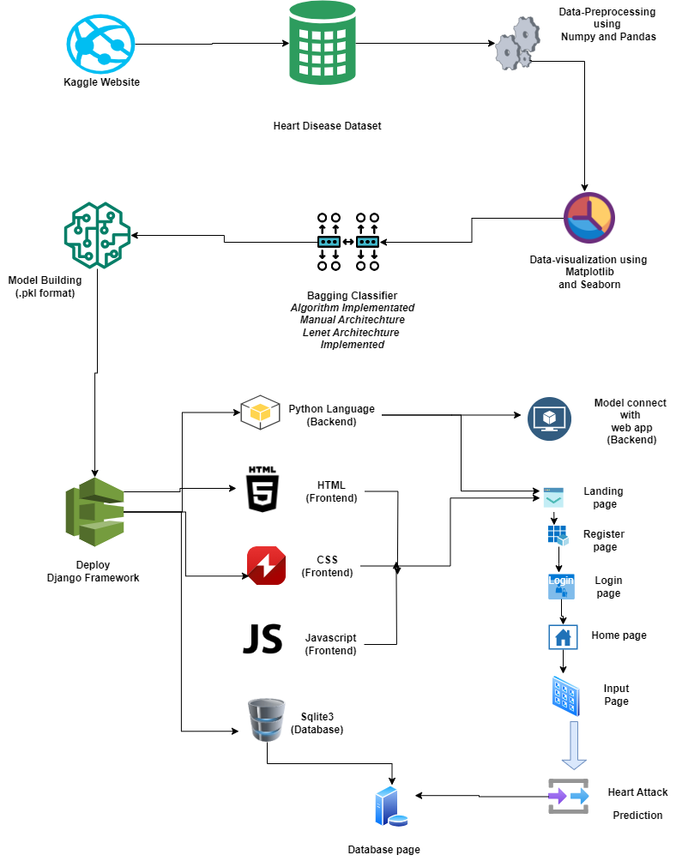
System Architecture :

Slide 19
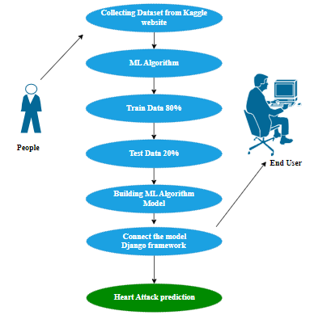
Use Case Diagram:

Slide 20
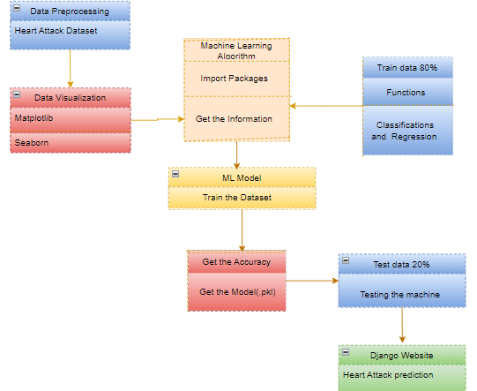
Class Diagram :

Slide 21
Module description:
Data Pre-processing
Validation techniques in machine learning are used to get the error rate of the Machine Learning (ML) model, which can be considered as close to the true error rate of the dataset.
If the data volume is large enough to be representative of the population, you may not need the validation techniques. However, in real-world scenarios, to work with samples of data that may not be a true representative of the population of given dataset. To finding the missing value, duplicate value and description of data type whether it is float variable or integer.
The sample of data used to provide an unbiased evaluation of a model fit on the training dataset while tuning model hyper parameters.

Slide 22
Data Validation/ Cleaning/Preparing Process:
Importing the library packages with loading given dataset. To analyzing the variable identification by data shape, data type and evaluating the missing values, duplicate values.
A validation dataset is a sample of data held back from training your model that is used to give an estimate of model skill while tuning model's and procedures that you can use to make the best use of validation and test datasets when evaluating your models.
Data cleaning / preparing by rename the given dataset and drop the column etc

Slide 23
Exploration data analysis of visualization
Data visualization is an important skill in applied statistics and machine learning.
Statistics does indeed focus on quantitative descriptions and estimations of data.
Data visualization provides an important suite of tools for gaining a qualitative understanding.
This can be helpful when exploring and getting to know a dataset and can help with identifying patterns, corrupt data, outliers, and much more.

Slide 24
Comparing Algorithm with prediction in the form of best accuracy result:
It is important to compare the performance of multiple different machine learning algorithms consistently and it will discover to create a test harness to compare multiple different machine learning algorithms in Python with scikit-learn.
It can use this test harness as a template on your own machine learning problems and add more and different algorithms to compare.
Each model will have different performance characteristics. Using resampling methods like cross validation, you can get an estimate for how accurate each model may be on unseen data.

Slide 25
Algorithm Explanation:
In machine learning and statistics, classification is a supervised learning approach in which the computer program learns from the data input given to it and then uses this learning to classify new observation.
This data set may simply be bi-class (like identifying whether the person is male or female or that the mail is spam or non-spam) or it may be multi-class too.
Some examples of classification problems are: speech recognition, handwriting recognition, bio metric identification, document classification etc

Slide 26

LANDING PAGE:

Slide 27
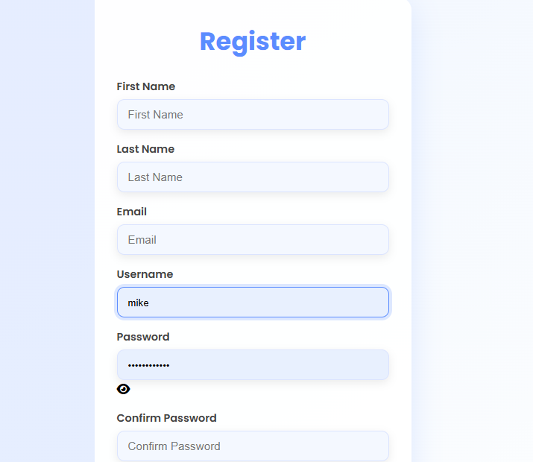
REGISTER PAGE:

Slide 28

LOGIN PAGE:

Slide 29

HOME PAGE:

Slide 30
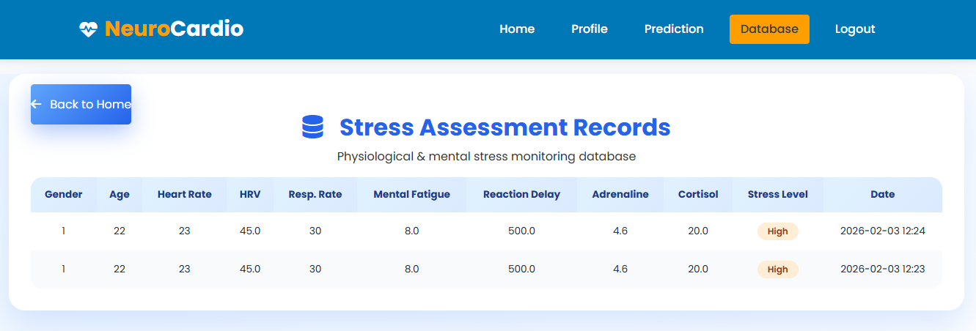
DATABASE PAGE:

Slide 31
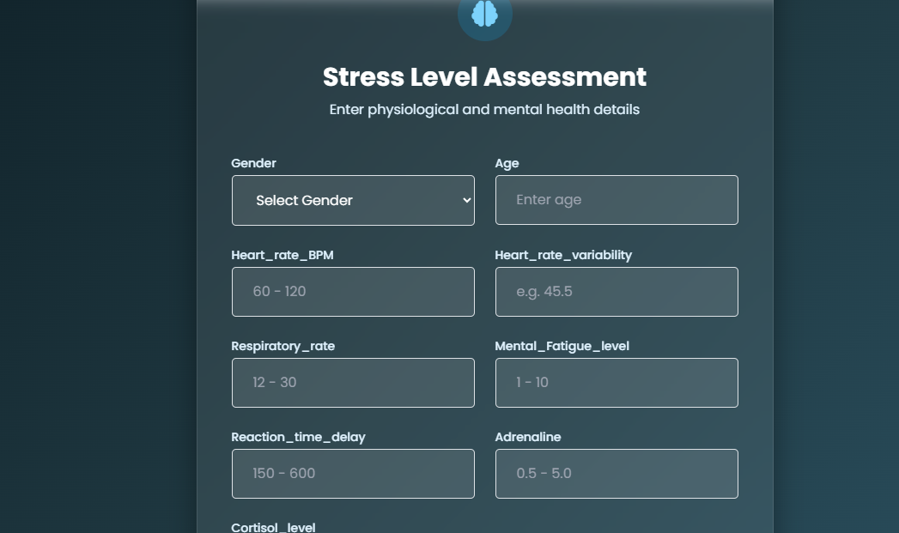
INPUT PAGE:

Slide 32
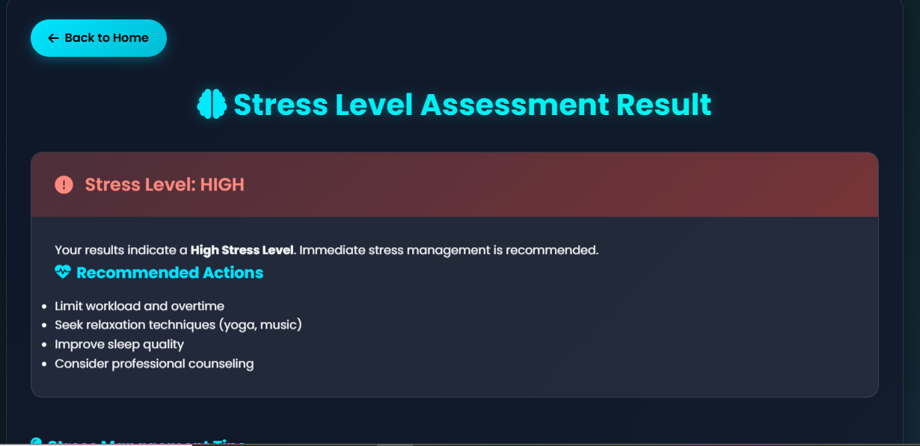
OUTPUT PAGE:

Slide 33
Conclusion:
The analytical process started from data cleaning and processing, missing value, exploratory analysis and finally model building and evaluation. The best accuracy on public test set is higher accuracy score will be find out. This application can help to find the Prediction of stress level using Neurocardio symptoms.

Slide 34
Future Work:
Heart Attack prediction to connect with cloud.
To optimize the work to implement in Artificial Intelligence environment.

